Slide 1
Making Your Voice Heard in an Already Crowded Conversation
Rachel Frost, MRCDC
Stacey Barta, DNRC

Slide 2
Outline for Public Comment Presentation
Be a part of the solution
Why should I comment?
When should I comment?
How do I know when public comment periods are open?
How to write substantive comments
What is a substantive comment?
How are comments used by the soliciting agency?
What is a substantive comment?
how to make sure my comment is heard and incorporated.
How are comments reviewed after being submitted?
How can CD’s work together for commenting?
Examples of how organizations are soliciting public comment

Slide 3
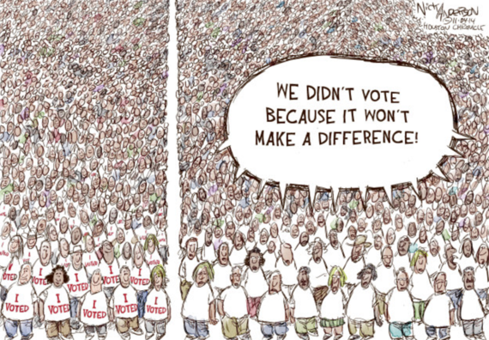
PARTICIPATE in the Public Process!
All progress takes place outside the comfort zone

Slide 4
Commenting is Part of the Public Process
If you aren’t at the table, you may be on the menu!
COMMENT

Slide 5
Why do Agencies Solicit Public Comments?
Be a part of the solution
Process built into the federal rule-making process
Administrative Procedures Act (1946) directs agencies to request comments on proposals by all members of the public
Agencies looking for information pertinent to the actions proposed in the regulation… from community impacts to scientific research.
Agencies required to take into account and respond to substantive comments
Notes:
public comment
is a mechanism that is already built in to the federal rule-making process. Federal agencies implement laws passed by Congress through rules and regulations. When any federal agency needs to create a new regulation, it starts with a regulation proposal in the Federal Register. Under the Administrative Procedures Act (1946), the agency is then required to request comments on that proposal by all members of the public.
Agencies are looking for any information pertinent to the actions proposed in the regulation, from public input on community impacts to scientific research. This means that public comment is utilized not only by private citizens, but also by non-profit organizations, industry lobbying groups, and even other government agencies. The agency is then required to take into account and respond to substantive comments when writing the final regulation. These responses are also published in the Federal Register. Agencies may also solicit public comment outside of proposed rules, for example, when soliciting information for a potential regulation or simply gathering information on a particular topic.

Slide 6
What Constitutes a Substantive Comment?
Do one thing every day that scares you
Substantive Comments Excerpts from the NEPA Handbook 6.9.2.1
“To be most helpful, comments should be as specific as possible. A substantive comment provides new information about the Proposed Action, an alternative to the analysis; identifies a different way to meet the need; points out a specific flaw in the analysis; suggests alternate methodologies and the reason(s) why they should be used; makes factual corrections, or identifies a different source of credible research which, if used in the analysis, could result in different effects.”
Notes:
Straight from BLM Effective Comment Guide

Slide 7
Substantive Comments
The way to get started is to quit talking and start doing
Do one or more of the following:
question, with reasonable basis, the accuracy of information in the EIS or EA.
question, with reasonable basis, the adequacy of, methodology for, or assumptions used for the environmental analysis.
present new information relevant to the analysis.
present reasonable alternatives other than those analyzed in the EIS or EA.
cause changes or revisions in one or more of the alternatives.
Notes:
“To say it a little differently….substantive comments do one or more of the following…”
Straight from BLM Effective Comment Guide

Slide 8
Substantive Comments often address:
Be a part of the solution
New scientific information or data that would have a bearing on the analysis;
Errors in the analysis, assumptions, methodology, or conclusions;
Misinformation that could affect the outcome of the analysis;
Requests for clarification; or
A substantive new alternative with a mix of allocations that differs from those under any of the proposed alternatives.
Comments will be most helpful if you can state specifically what you like and what you don't like, and what improvements you think can be made. Suggest changes and be specific.
reference a section or page number.
Comments containing only opinion or preferences will be considered as part of the decision making process, but they will not receive a formal response from the BLM.
Be sure to tell us what concepts you do support, not just those you don’t like. Without support, good actions run the risk of being revised.
Notes:
Straight from BLM Effective Comment Guide

Slide 9
Non-substantive comments:
The secret to success is to know something nobody else knows
comments in favor of or against the proposed action or alternatives without reasoning (such as “we disagree with Alternative Two and believe the BLM should select Alternative Three”)
comments that only agree or disagree with policy or resource decisions without justification or supporting data (such as “more grazing should be permitted”).
comments that don’t pertain to the project area or the project (such as “the government should eliminate all dams,” when the project is about a grazing permit).
comments that take the form of vague, open-ended questions.
Notes:
Straight from BLM Effective Comment Guide

Slide 10
The Truth about Form Letters
The most courageous act is still to think for yourself….aloud
A single, well-supported comment may carry more weight than a thousand form letters.
Agencies must treat identical comments as one comment.
Form letters can slow down the process without adding value
Notes:
Organizations love form letters to make a big statement of support or opposition….
BLM must treat identical comments as one comment. It is more important to raise unique issues that are important to you than it is to reiterate someone else’s comment.
Each form letter must be reviewed to ensure that it does not contain any additional statements that constitute a substantive comment. This takes up lots of time and personnel resources. For example, over 2,000,000 comments received on the review of national monuments. Estimated at less than 1,000 unique comments, substantive likely less than 100. Mostly emotional rants on both sides.
Organizations often encourage their members to submit form letters designed to address issues common to their membership. Organizations including industry associations, labor unions, and conservation groups sometimes use form letters to voice their opposition or support of a proposed rulemaking. Many in the public mistakenly believe that their submitted form letter constitutes a “vote” regarding the issues concerning them. Although public support or opposition may help guide important public policies, agencies make determinations for a proposed action based on sound reasoning and scientific evidence rather than a majority of votes. A single, well-supported comment may carry more weight than a thousand form letters.

Slide 11
Commenting is NOT voting
Old ways won’t open new doors
The number of negative comments an agency receives does not prevent an action from moving forward.
Nor do the sheer number of comments received influence which alternative is selected in the EIS.
HOWEVER, by pointing out flaws in an alternative, you can revise the scope or the acceptability of the alternative
Notes:
Agencies make determinations for a proposed action based on sound reasoning and scientific evidence rather than a majority of votes.
Public comment on RMPs is not a voting process, nor is commenting a form of “voting on an alternative in an EIS.

Slide 12
IS it Substantive or Not?
IS IT SUBSTANTIVE OR NOT?
Notes:
Now it’s time to play the newest game show…..IS IT SUBSTANTIVE OR NOT?

Slide 13
Is it Substantive or Not?
The reward for conformity is that everyone likes you, except yourself
Closing the national monuments would lose massive tourist revenue for states. Per the Outdoor Industry Association, every year, outdoor recreation in the United States generates $887 billion in consumer spending and 7.6 million jobs.
The U.S. Department of the Interior has reported that visits to our National Parks added $35 billion to the U.S. economy. These monuments help create economic prosperity and jobs in local communities for decades.

Slide 14
IS it Substantive or Not?
Never confuse motion with action
“These monument designations are absolutely stupid! No one needs that much land designated for recreation. States should control all land within their borders”

Slide 15
IS it Substantive or Not?
Nature takes away any faculty not used
Such designations can restrict or eliminate opportunities for responsible off-highway motorized recreation on public lands and negatively affect the economies of the communities surrounding the monuments. For example, the Grand Staircase-Escalante National Monument closed half of the existing routes open to motorized recreation. The federal land managers even prohibited off-highway motorcyclists from riding the graded, gravel roads. Fortunately, the affected county asserted its jurisdiction over those roads, but not before having to fight the federal land managers in court. At the Canyons of the Ancients National Monument, federal land managers first closed the single-track trails, then prohibited motorcycles from roads for four-wheeled vehicles. Clearly, these designations did not consider the multiple-use policy of section 102(a)(7) of the Federal Land Policy and Management Act (43 U.S.C. 1701(1)(7)).
Notes:
I, along with the AMA, support the review as a way to determine whether some monument designations included more land than necessary as defined by the Act. I also believe presidents should solicit input from the public before making such designations, even though the law does not require it. I oppose sweeping monument designations by administrations that fail to consider input from all stakeholders. Such designations can restrict or eliminate opportunities for responsible off-highway motorized recreation on public lands and negatively affect the economies of the communities surrounding the monuments. The Antiquities Act grants the president authority to designate national monuments to protect "historic landmarks, historic and prehistoric structures and other objects of historic or scientific interest" that are on federal lands. The law limits the size of the designations to "the smallest area compatible with proper care and management of the objects to be protected." Previous administrations have used the broadly defined stipulations of the Antiquities Act to create monument designations. Unfortunately, these broad designations have closed larger-than-necessary territories that were previously used for wholesome recreation, such as responsible motorized recreation that supports small business and local economies. The designation of National Monuments on public lands may reduce or end access for responsible motorized recreation. Designations can be made that will benefit all groups, as long as these groups are given the opportunity to contribute their perspectives. Excerpts from an AMA guest blog written by Clif Koontz address the Grand Staircase-Escalante, Canyons of the Ancients and Bears Ears National Monuments. Koontz is the executive director of Ride with Respect, a nonprofit organization based in Moab, Utah, that conserves shared-use recreation through trail work and education. Koontz states, "The Grand Staircase-Escalante National Monument closed half of the existing routes open to motorized recreation. The federal land managers even prohibited off-highway motorcyclists from riding the graded, gravel roads." He added, "Fortunately, the affected county asserted its jurisdiction over those roads, but not before having to fight the federal land managers in court." At the Canyons of the Ancients National Monument, Koontz says, federal land managers first closed the single-track trails, then prohibited motorcycles from "motorcycle trails" that actually were roads for four-wheeled vehicles. Those roads are a far cry from the actual single-track trails they had closed to responsible recreation." For the new Bears Ears National Monument, Koontz states, it "encircles many 4WD roads, ATV trails and motorcycle trails where Ride with Respect has worked. ... If history is any guide, these routes will eventually be closed due to the national monument status, despite the fact that we've made them sustainable, not to mention that they avoid archaeological sites." However, the AMA believes some previous monument designations go beyond the "requirements and original objectives of the Act." Moreover, these designations did not consider the multiple-use policy of section 102(a)(7) of the Federal Land Policy and Management Act (43 U.S.C. 1701(1)(7)). The AMA and I support the protection of our national treasures by using a process that involves state officials, local stakeholders, governors and Congress. Again, I applaud the Interior Department for seeking public comments on its review of certain National Monuments.

Slide 16
IS it Substantive or Not?
Victory belongs to the most persevering
“None of the National Monuments currently under review should be altered or touched in any way.”
“I am opposed to any possibility of selling or privatizing public lands.”

Slide 17
IS it Substantive or Not?
Victory belongs to the most persevering
As a retired BLM Botanist, I have personally documented of a number of endemic plant species found only within the Organ Mountains. Loss of monument status could prevent these plants from being further studied and protected from extinction.

Slide 18
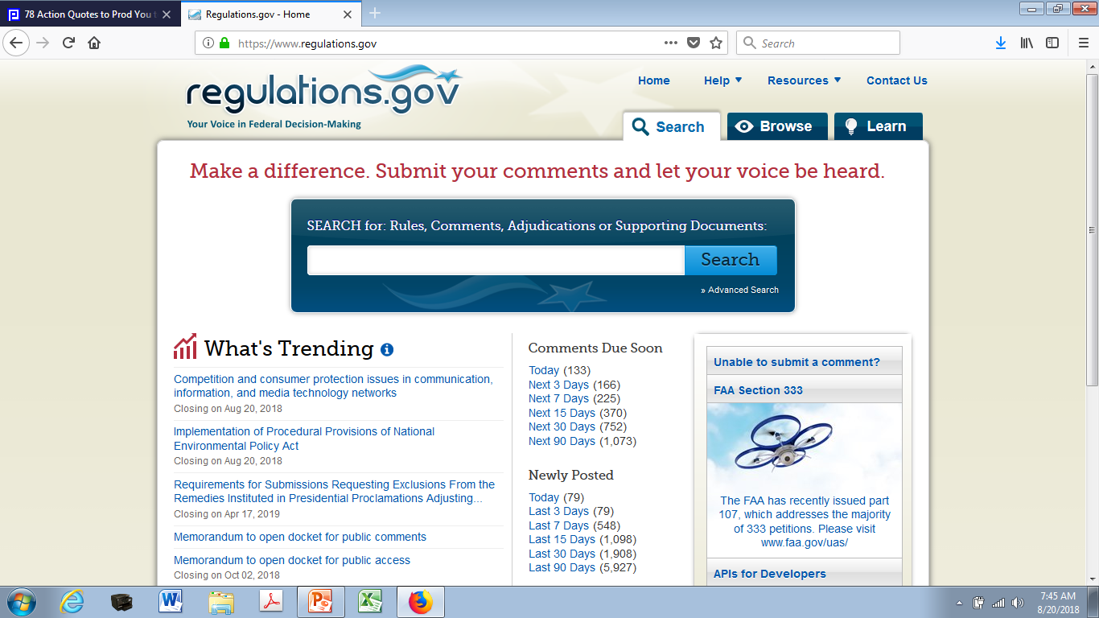
Regulations.gov – Gateway to public comment notification and submission
What you do speaks so loudly that I cannot hear what you say

Slide 19
Agency response to public comment
Be a part of the solution
In accordance with the Administrative Procedures Act, federal agencies are legally required to respond to every unique, fact-based comment.
Responses are published, along with the final rule or action, in the Federal Register.
No respond to such a comment, or "arbitrary and capricious," response may be challenged in court
Notes:
the commenter has cause to take the agency to court for violating procedural law. This is primarily done by a special interest group with extra resources, rather than an average citizen.

Slide 20
Tracking the effect of your comment
If you wait, all that happens is that you get older
So you've commented - now what?
Submitted through Regulations.gov?
email notifications about any newly posted documents related to the that regulation
publication of the final rule, along with the agency responses to substantive comments
Notes:
If you submitted your comment through the online portal at Regulations.gov, you can sign up to receive email notifications about any newly posted documents related to the that regulation.

Slide 21
How is my comment evaluated by the agency?
You will either step forward into growth or backward into safety
Does the comment:
raise a topic that could cause change to the EIS in a substantive way, such as adding an alternative?
raise a topic that should be forwarded to a subject matter expert for detailed review?
raise a topic that should be forwarded to a cooperating agency for review?
help improve the quality or clarity of the analysis or the accuracy and completeness of the final EIS?
indicate a better way to define or describe the proposed action or alternatives?
suggest how to make the EIS more understandable?

Slide 22
A well-written agency response:
Preach! Write! Act! Do anything save to lie down and die
Is respectful in tone, factual, and informative.
Provides a level of detail appropriate to thee comment
Addresses all substantive elements of the comment
Summarizes revisions to the EIS that resulted from the comment and specifically identifies modified sections of the EIS
Is straightforward and promotes better understanding of the proposal and its potential impacts

Slide 23
Tips for CDs and citizens:
Always do more than is required of you
Sign up for notifications of public comment opportunities
Start early in the comment process: 30 days will pass quickly, especially in a busy season
Don’t begin at the beginning
Skim to parts that affect you
Enlist help!
County extension agents
County commissioners
Local agency staff
Neighbors
MACD / DNRC
Share main points with others
Allow local ecological knowledge to make unique

Slide 24
Tips on Effective Comments
The secret to success is to do the common thing uncommonly well
A constructive comment that provides information to support an argument is more likely to inform the agency’s decision-making process.
Identify the docket ID number and other identifying information (e.g., subject heading, Federal Register date and page number) in your subject line.
Read and understand the document you are commenting on
contact person named in the document
Follow directions provided to ensure you submit an appropriate comment
Be concise but support your claims.
avoid the use of profanity or personal threats.
Explain why you agree or disagree
suggest alternatives and substitute language for your requested changes.
Provide specific examples to illustrate your concerns and suggest alternatives.
Base your comments on sound reasoning, scientific evidence, and/or how you will be impacted by the agency’s proposal.
Address trade-offs and opposing views.
Submit your comments by the comment period
Notes:
A comment that expresses support or disagreement for a particular action provides general feedback to EPA. However, a comment that is constructive and provides information to support an argument is more likely to inform EPA’s decision-making process.The following tips are meant to help you prepare your comments.
Identify the docket ID number and other identifying information (e.g., subject heading, Federal Register date and page number) in your subject line. Comments cannot be considered if they are misdirected or get lost because the identifying information was not included.
Read and understand the document you are commenting on. If you have difficulty understanding it, please reach out to the EPA contact person named in the document. Describe that difficulty in your comments, along with the clarification you received.
Follow directions provided. The Agency may ask you to respond to specific questions, provide particular information or organize comments in a particular way to facilitate their processing once received by EPA. If your comment is about a particular proposed regulatory provision, include the reference to the proposed part and section number for the Code of Federal Regulations (CFR).
Be concise but support your claims. Explain your views as clearly as possible, avoiding the use of profanity or personal threats. Explain why you agree or disagree; suggest alternatives and substitute language for your requested changes. Provide specific examples to illustrate your concerns and suggest alternatives.
Base your comments on sound reasoning, scientific evidence, and/or how you will be impacted by the agency’s proposal. Describe any assumptions and provide the technical information and/or data that you used. If you estimate potential costs or burdens, explain how you arrived at your estimate in sufficient detail to allow for it to be reproduced.
Address trade-offs and opposing views.
The comment process is not a vote – one well-supported comment is often more informative to the agency than a thousand form letters.
Make sure to submit your comments by the comment period deadline identified in the Federal Register document.
View the rules and restrictions on comments to be sure you submit an appropriate comment.

